Slide 1
Graphing Quantitative Data
Chapter 3

Slide 2
3 Graphs for Quantitative Data
Type of Graph
Advantage
Dot Plot
Histogram
Box Plot
Retains individual data
Displays shape
Displays center & spread

Slide 3
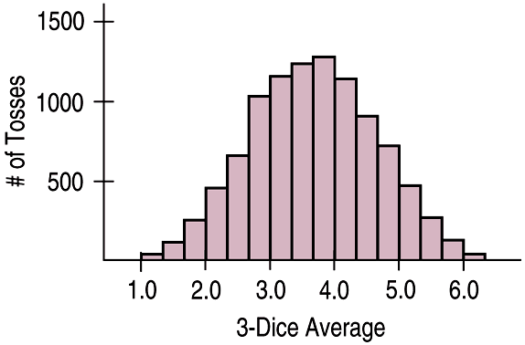
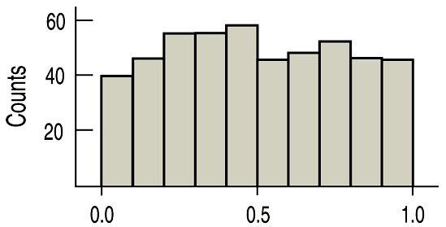
Shape
Symmetric
Uniform
Right Skewed
Left Skewed

Slide 4
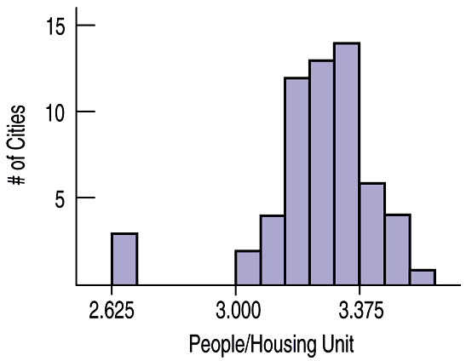
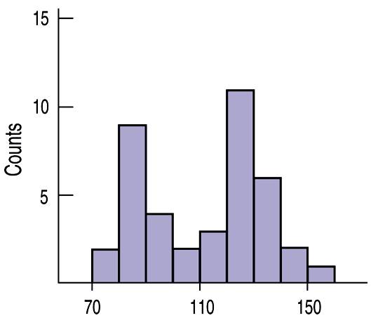
Other Attributes for Shape
Outliers (Unusual data compared with the other data)
Modes (# of Humps)
Unimodal
(One hump)
Bimodal
(Two humps)
Multimodal
(Many humps)

Slide 5

Center Depends on Shape
If Symmetric:
If Skewed:
Use mean (average)
$$\overline{x}=\frac{x_{1}+x_{2}+…}{n}$$
Use median
This value will have half the data values below it and half above it
This value is pulled in the direction of outliers
*We let the calculator calculate this!

Slide 6

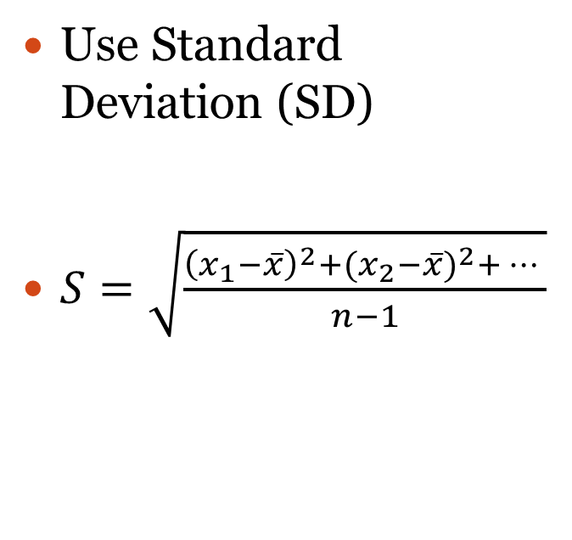
Spread Depends on Shape
If Symmetric:
If Skewed:
Use Standard Deviation (SD)
$S=\sqrt{\frac{{\left(x_{1}−\overline{x}\right)}^{2}+{(x_{2}−\overline{x})}^{2}+… }{n−1}}$
Use Interquartile Range (IQR)
$${IQR=Q}_{3}−Q_{1}$$
*The calculator can calculate the
5 # Summary but you should memorize
the IQR formula!
*We let the calculator calculate this!

Slide 7
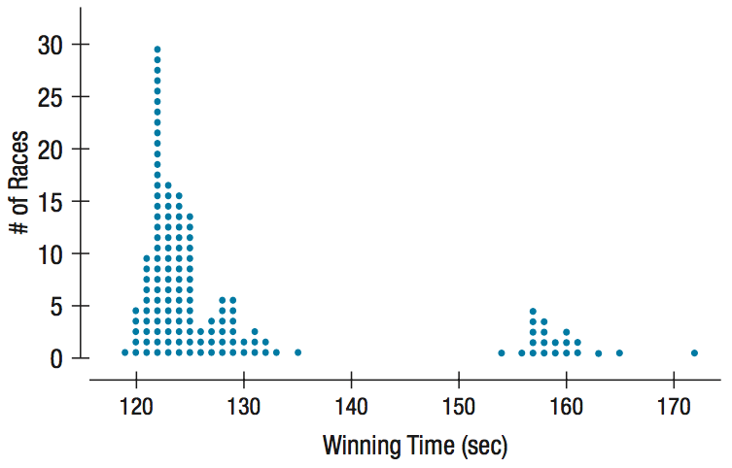
Dot Plot
Kentucky Derby Winning Times
Retains Individual
Lable Both Axes
Scale on Both Axes
Title
Shows Shape
Shows Modes
Shows Outliers

Slide 8
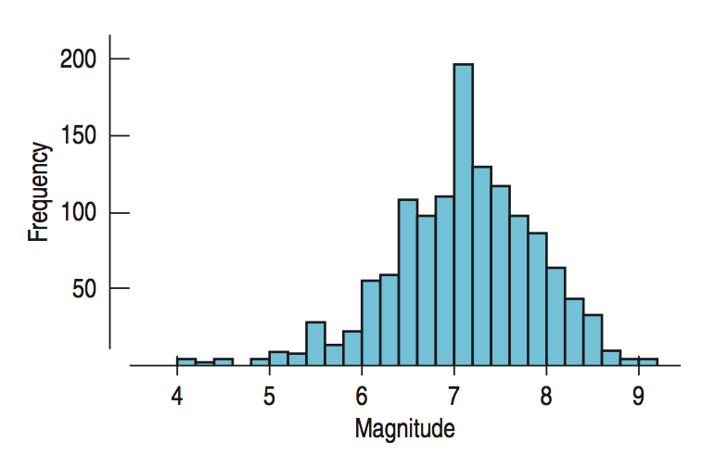
Histogram
Earthquake Magnitudes
Stores Data in Bins
Lable Both Axes
Scale on Both Axes
Title
Shows Shape
Shows Modes
Shows Outliers

Slide 9
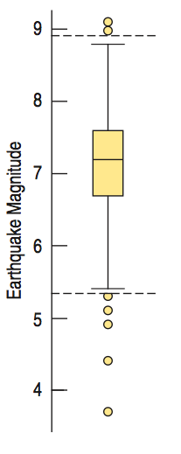
Box Plot
Earthquake Magnitudes
Max
Right Fence
Lable Axis
Scale on Axis
Title
Shows Center
Shows Spread
Q3
Center = Median
Q1
Left Fence
Min

Slide 10
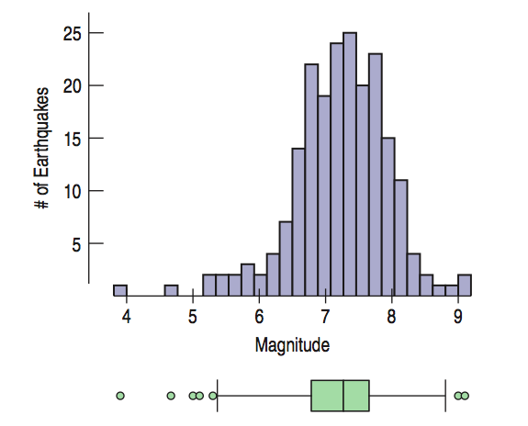
Big Picture
Earthquake Magnitude
Always graph both using same scale to get big picture of shape, center, and spread

Slide 11
L1 # of Pets for each student
0
0
1
1
1
1
2
2
2
2
2
3
3
4
5
Enter Quantitative Data
STAT
EDIT
Highlight L1
CLEAR
ENTER
Enter data values

Slide 12
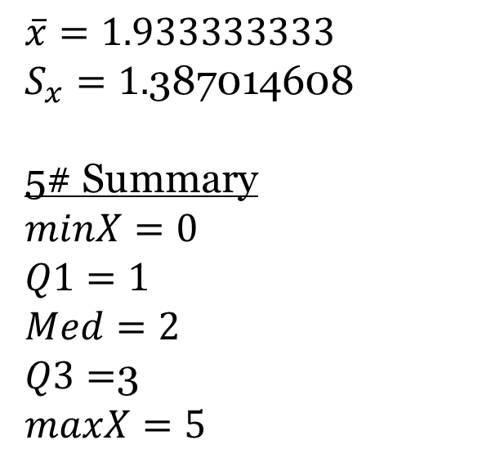
To Calculate Statistics
$$\overline{x}=1.933333333$$
$S_{x}=1.$387014608
5# Summary
$$minX=0$$
$$Q1=1$$
$$Med=2$$
$Q3=$3
$$maxX=5$$
STAT
CALC
1-VAR STAT
Depending on your calculator
ENTER
OR
List: L1
FreqList: blank
Calculate

Slide 13
To Graph Histogram
STAT PLOT
PLOT 1
ENTER on “ON”
Type: Choose Histogram
Xlist: L1
FreqList: 1
WINDOW
Xmin=0 Ymin=0
Xmax=6 Ymax=6
Xscl=1 Yscl=1
GRAPH
# of Students
# of Pets
*You can TRACE the values

Slide 14
To Graph Box Plot
# of Pets
STAT PLOT
PLOT 1
ENTER on “ON”
Type: Choose Box Plot
Xlist: L1
FreqList: 1
WINDOW
Xmin=0 Ymin=0
Xmax=6 Ymax=6
Xscl=1 Yscl=1
GRAPH
MaxX=5
# of Pets
Q3=3
Med=2
Q1=1
MinX=0
*You can TRACE the values

Slide 15
# of Pets for each student
Enter Quantitative Data
0 | 0 | 1 | 1 | 1 | 1 | 2 | 2 | 2 | 2 | 2 | 3 | 3 | 4 | 5
STAT
EDIT
Highlight L1
CLEAR
ENTER
Highlight L2
CLEAR
ENTER
Enter data values
It is easier to enter this data as a frequency table instead because of the repeating data values
L1 # of Pets | L2 Frequency
0 | 2
1 | 4
2 | 5
3 | 2
4 | 1
5 | 1

Slide 16
To Calculate Statistics
$$\overline{x}=1.933333333$$
$S_{x}=1.$387014608
5# Summary
$$minX=0$$
$$Q1=1$$
$$Med=2$$
$Q3=$3
$$maxX=5$$
STAT
CALC
1-VAR STAT
Depending on your calculator
L1, L2 ENTER
OR
List: L1
FreqList: L2
Calculate

Slide 17
To Graph Histogram
STAT PLOT
PLOT 1
ENTER on “ON”
Type: Choose Histogram
Xlist: L1
FreqList: L2
WINDOW
Xmin=0 Ymin=0
Xmax=6 Ymax=6
Xscl=1 Yscl=1
GRAPH
# of Students
# of Pets

Slide 18
To Graph Box Plot
# of Pets
STAT PLOT
PLOT 1
ENTER on “ON”
Type: Choose Box Plot
Xlist: L1
FreqList: L2
WINDOW
Xmin=0 Ymin=0
Xmax=6 Ymax=6
Xscl=1 Yscl=1
GRAPH
MaxX=5
# of Pets
Q3=3
Med=2
Q1=1
MinX=0

Slide 19
New Example
In 2018-2019 season, there were nine defensive players on the Orlando Solar Bears hockey team. The number of total minutes each player had spent in the penalty box during the season were 4, 6, 6, 10, 10, 12, 22, 41, and 122. (Yes, Mike Monfredo really had 122 penalty minutes so far in that season!)
Calculate the statistics and graph both a histogram and box plot.

Slide 20
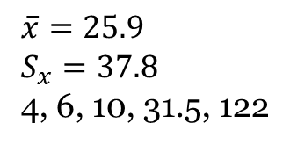
Solution
In 2018-2019 season, there were nine defensive players on the Orlando Solar Bears hockey team. The number of total minutes each player had spent in the penalty box during the season were 4, 6, 6, 10, 10, 12, 22, 41, and 122. (Yes, Mike Monfredo really had 122 penalty minutes so far in that season!)
Calculate the statistics and graph both a histogram and box plot.
$$\overline{x}=25.9$$
$$S_{x}=37.8$$
4, 6, 10, 31.5, 122

Slide 21
Solution
In 2018-2019 season, there were nine defensive players on the Orlando Solar Bears hockey team. The number of total minutes each player had spent in the penalty box during the season were 4, 6, 6, 10, 10, 12, 22, 41, and 122. (Yes, Mike Monfredo really had 122 penalty minutes so far in that season!)
Calculate the statistics and graph both a histogram and box plot.
$$\overline{x}=25.9$$
$$S_{x}=37.8$$
4, 6, 10, 31.5, 122
Now describe the shape, center, and spread

Slide 22
Solution
In 2018-2019 season, there were nine defensive players on the Orlando Solar Bears hockey team. The number of total minutes each player had spent in the penalty box during the season were 4, 6, 6, 10, 10, 12, 22, 41, and 122. (Yes, Mike Monfredo really had 122 penalty minutes so far in that season!)
Calculate the statistics and graph both a histogram and box plot.
$$\overline{x}=25.9$$
$$S_{x}=37.8$$
4, 6, 10, 31.5, 122
Describe the shape, center, and spread
Shape: Right Skewed, Unimodal
One outlier at 122
Center = Median = 10
Spread = IQR = Q3 – Q1 = 31.5 - 6 = 25.5

Slide 23
How do we know about outliers?
We need to calculate the left fence and the right fence.
Left fence = $Q1−1.5\left(IQR\right)$
Left fence = 6 – 1.5(25.5) = -32.25
Do we have any data values smaller than -32.25?
Nope! So no outliers on left side!
Right fence = $Q3+1.5\left(IQR\right)$
Left fence = 31.5 + 1.5(25.5) = 69.75
Do we have any data values larger than 69.75?
Yep! So 122 is an outlier on the right side!
*Notice the Box Plot on the previous slide, the tail goes to 41 which is the last data value that is not an outlier.
* You should memorize the left and right fence formulas!

Slide 24
Homework
Complete Quiz Chapter 1-2
Complete HW Chapter 3
Read Cinderella PP

